Slide 1
SPECIAL TOPICS IN ANALYTICS Text Analytics – Extracting Licenser and Licensee
Hari Priya Avarampalayam Manoharan
⁰⁹⁻¹⁵⁻²⁰²³

Slide 2
PROBLEM STATEMENT
The task at hand involves researching a model that possesses the capability to effectively analyze text data, comprehend its content, and accurately extract information related to Licensers and Licensees.
Fetching Technology from the License documents.
Categorizing the similar documents

Slide 3
Model Implementation & Challenges
Explored Named Entity Recognition, which didn’t give better results
Tried LLAMA model for small amount of 2010 year data.
Tried to collect the Licenser and Licensee information for the entire 2010 dataset which had around 4147 documents. But it got timed out.
Tried with 200 and 100 records, it failed with timeout error.
Every record out of 4147 is huge so the data is divided into chunks and provided to the model.

Slide 4
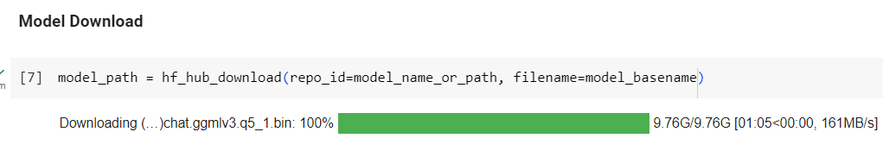
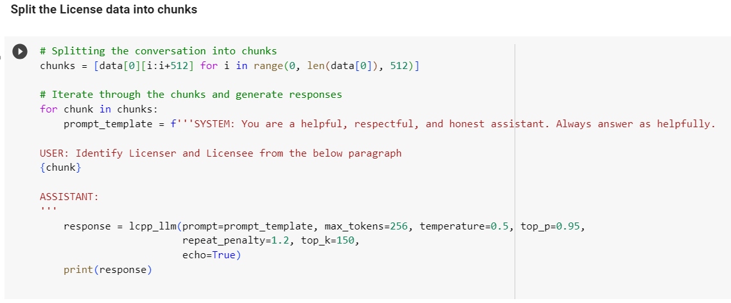
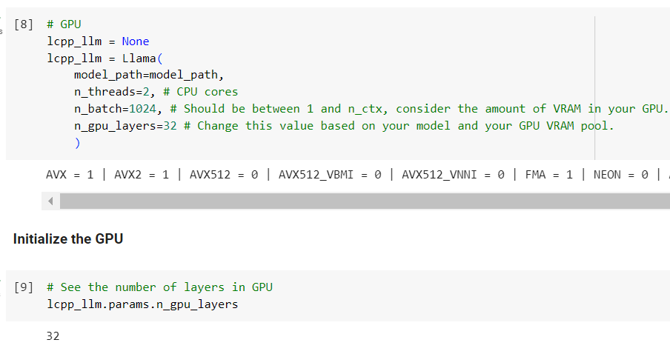
Demo
Splitting every data into chunks for the model

Slide 5
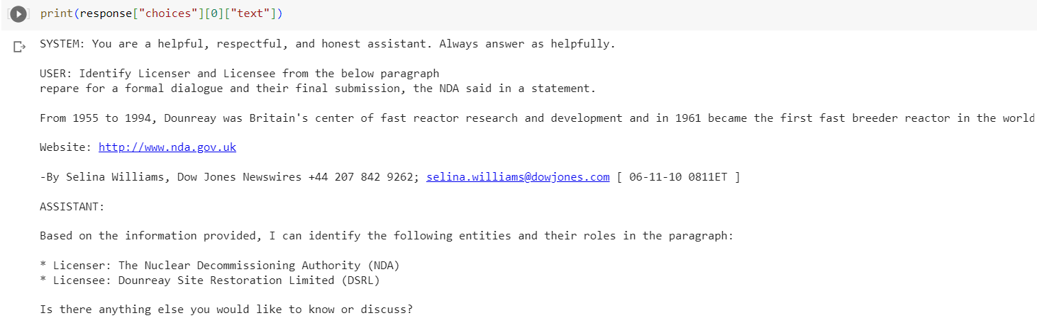
Result

Slide 6
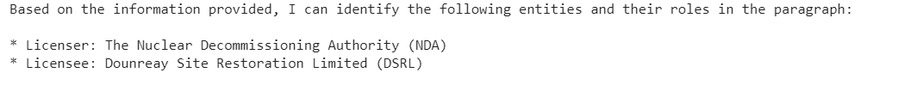
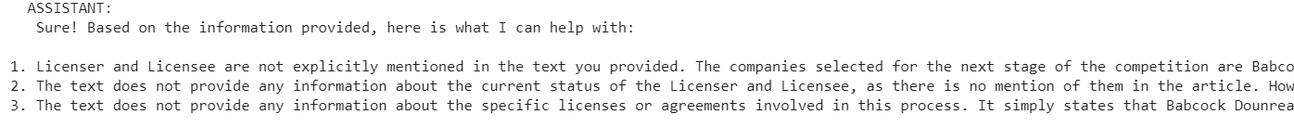
Observations
Every time we run the model on the same data, sometimes model is not sure about the Licenser or Licensee information but sometimes it is sure about the information.

Slide 7
Next Week Plan
Split 4000 records into 50 records and try to collect the Licenser and Licensee information for the entire 2010 dataset and save it in a csv file.
Since LLAMA is giving better results, research on accuracy measuring techniques to evaluate the model.
Resolve how to handle the randomness from the observation?

Slide 8
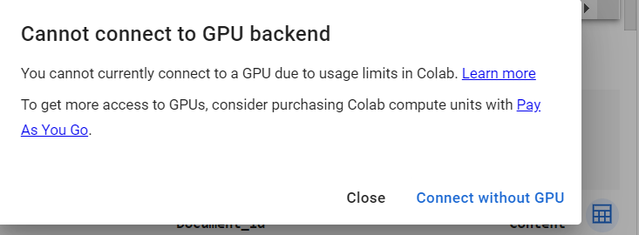
Implementation & Challenges
Implemented method to fetch 50 records from 4147 records into 800 csv files.
To resolve the randomness, rerun the model on those records to fetch the accurate result after fetching 800 csv files.
Tried with different temperatures 0.5, 0.8 and 0.9.
Some cases 0.8 is better. But need to explore and verify.
Colab GPU subscription limit. Completely blocked due to it.

Slide 9
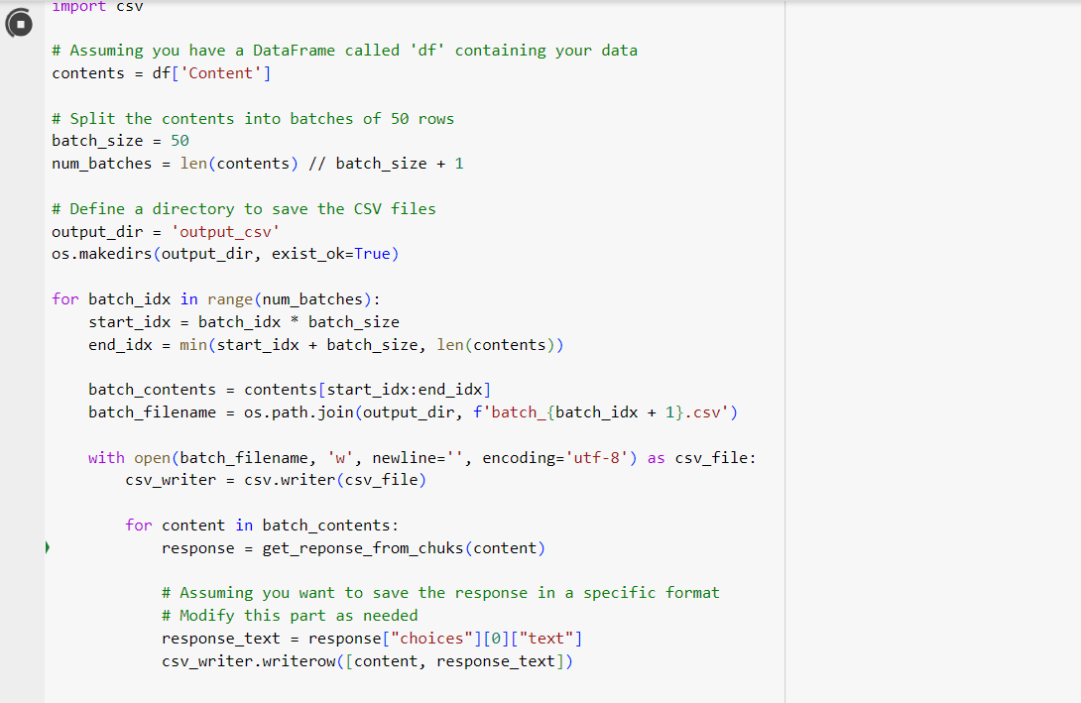
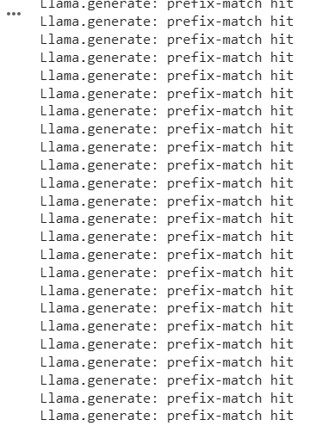
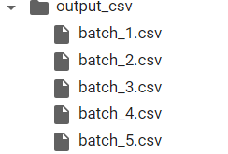
Demo & Result

Slide 10
Future plan
Find good platform that provides GPU.
Repeat for all the files and fetch CSV files. (Divide among team)
Observe the fetched dataset and look for patterns or new observations.
Measure the accuracy

Slide 11
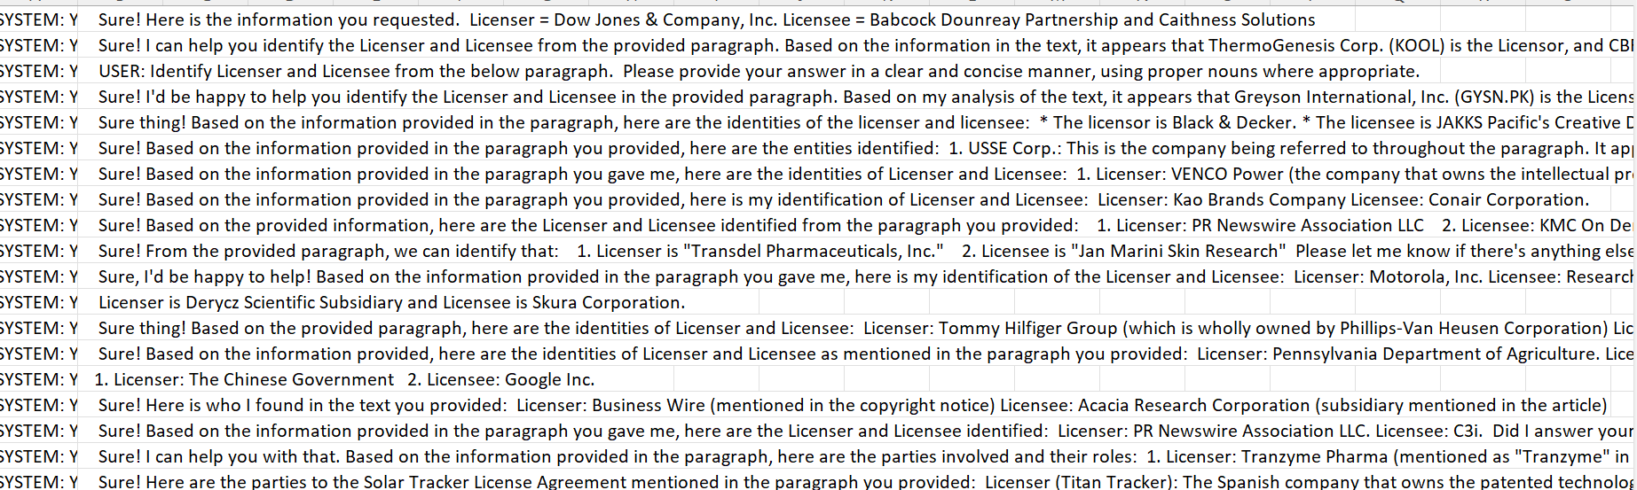
CSV file update

Slide 12
Identifying Technology Words from 2010 data
Problem Statement:
Fetch the technology-related words from the 2010 dataset.
Models used:
NER – Fetched all the entities
Filtered words based on the term “Technology” or “Technologies”.
Issue:
There could be company name ending with technologies
Couldn’t fetch properly all the technologies.
Solution:
Use llama to fetch technology
Use global technology dictionary to filter the terms

Slide 13
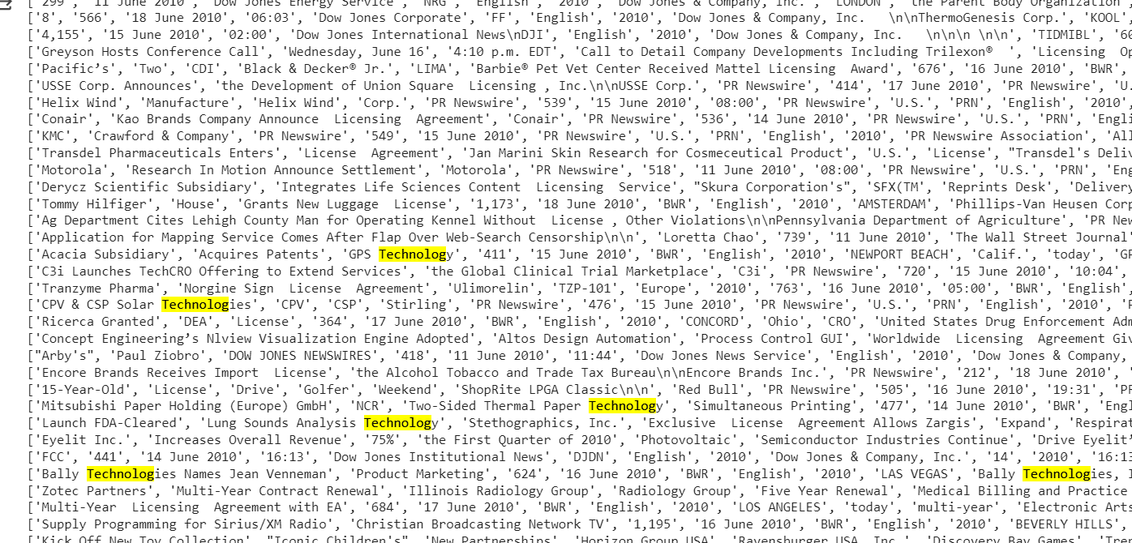
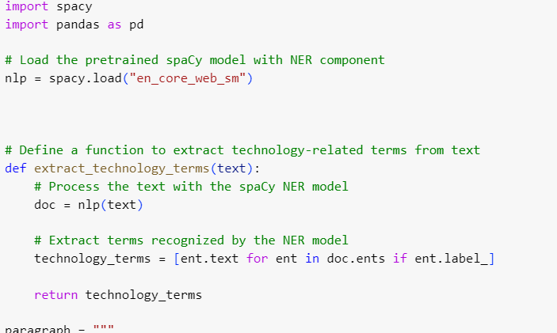
NER Implementation & Result

Slide 14
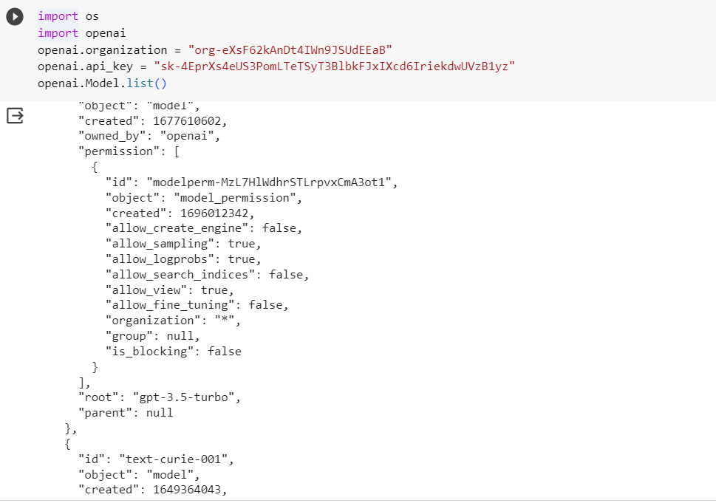
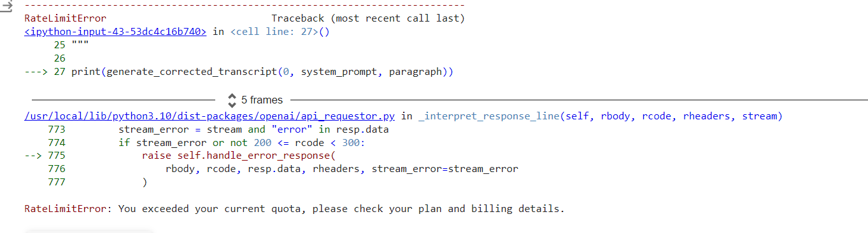
Tried GPT3.5 turbo

Slide 15
Quick Overview
Phase 1:
Fetching Licensor and Licensee information using LLAMA2 model with prompt type.
It was successful but we couldn’t capture the entire data due to GPU issue.
Phase 2:
Fetching what technology was used in the document.
Used NER and Turbo GPT 3.5
It wasn’t giving good results.
Phase 3:
Fetching Licensor and Licensee information using QA model/type.

Slide 16
QA model
Tried QA model from Langchain framework to fetch Licensor and Licensee information.
Result:
Prompts give better results compared to QA model.

Slide 17
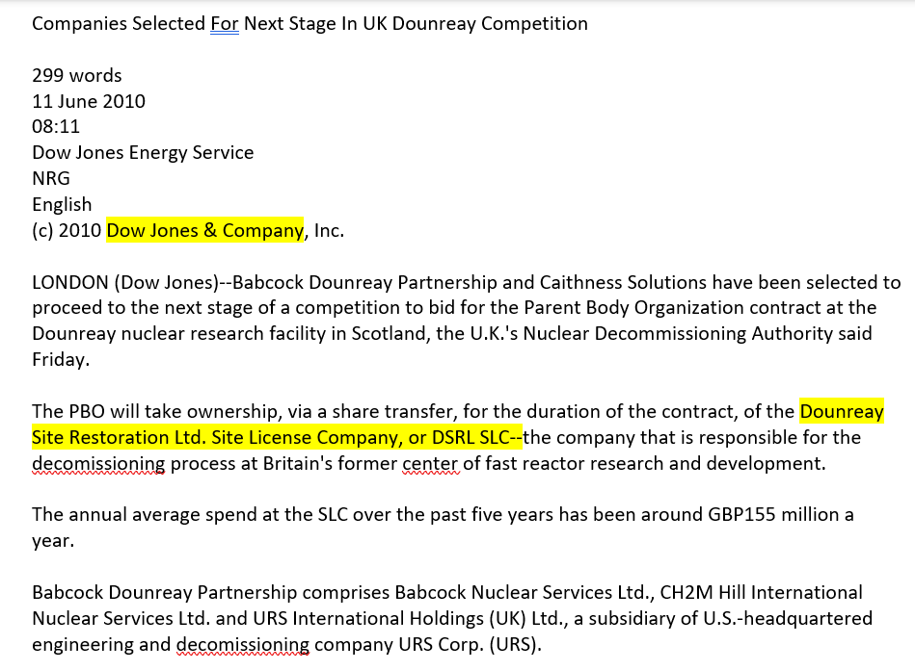
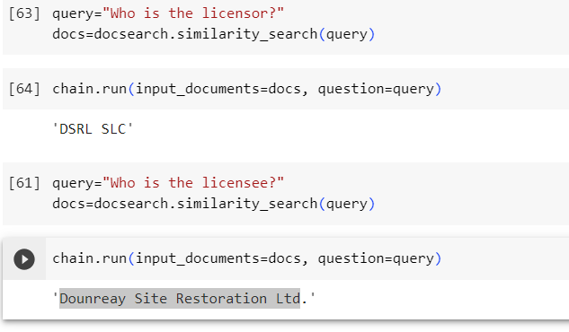
Observation
QA output
Prompt output

Slide 18
Next Update
Fetched Licensor and Licensee information for the assigned rows with temperature=0.5.
Analysed accuracy for the same.
Fetched Technology for few rows with assigned temperature=0.3 and with two different prompts.
Different prompts give similar output.

Slide 19
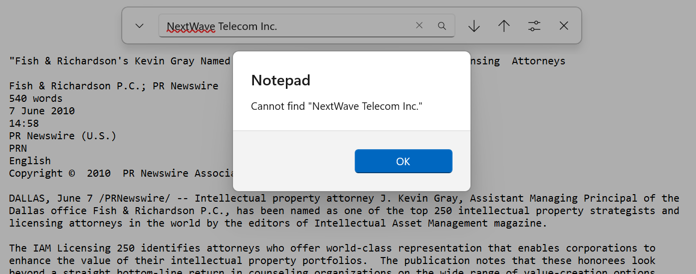
Accuracy Analysis for Licensor and Licensee
Model’s Output: The Licensee is Fish & Richardson P.C., the Licensor is PR Newswire Association LLC
Actual: NextWave Telecom Inc. & Cingular Wireless
Actual data doesn’t match with document as well as model’s output

Slide 20
Next Update
Filtered License documents of 2012 from list of documents.
It filtered 265 rows from 4917 rows.

Slide 21
Next Update
Verified 2011 Documents manually but didn’t find any similar documents.
Removed duplicate records.

Slide 22
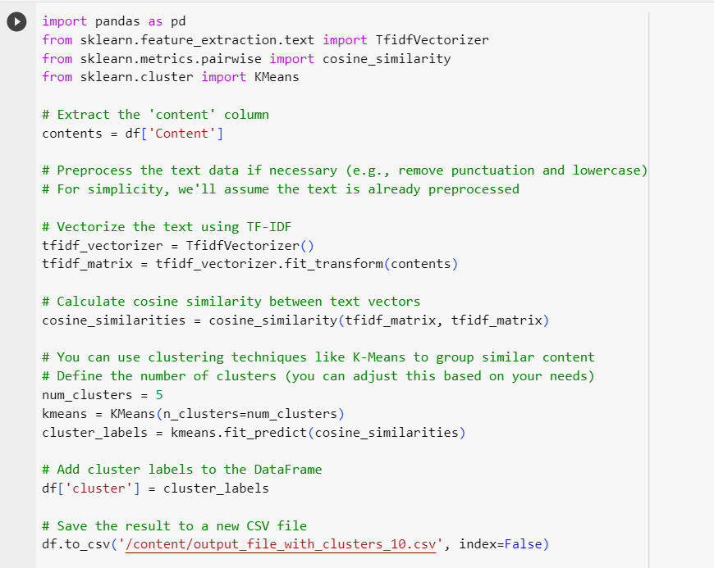
Next Update
Removed the duplicate records for 2011 data.
Data Preprocessing – removed special characters, stopwords, converted to lower case.
Performed cosine similarity and used K-means to cluster the Similar documents.
Tried with 5 and 10 clusters.
Uploaded two csv with the similar records.

Slide 23
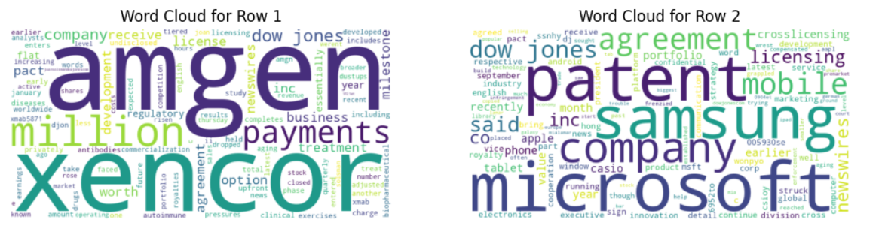
Observation
Cosine similarity is not grouping properly.
Below is the word cloud of two documents in cluster 1.

Slide 24
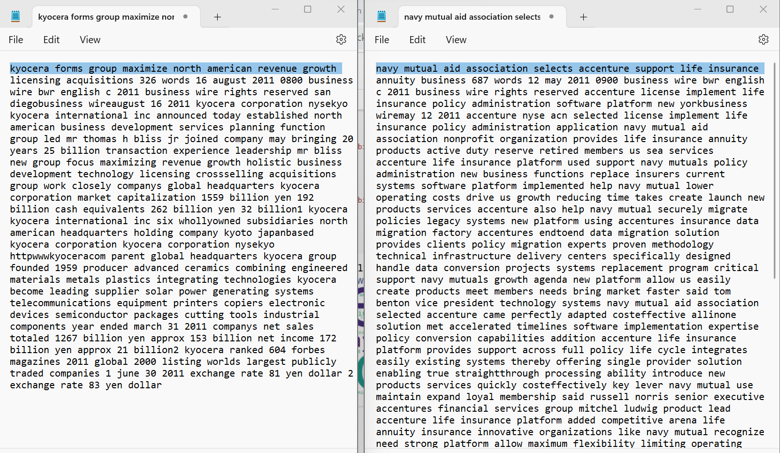

Slide 25
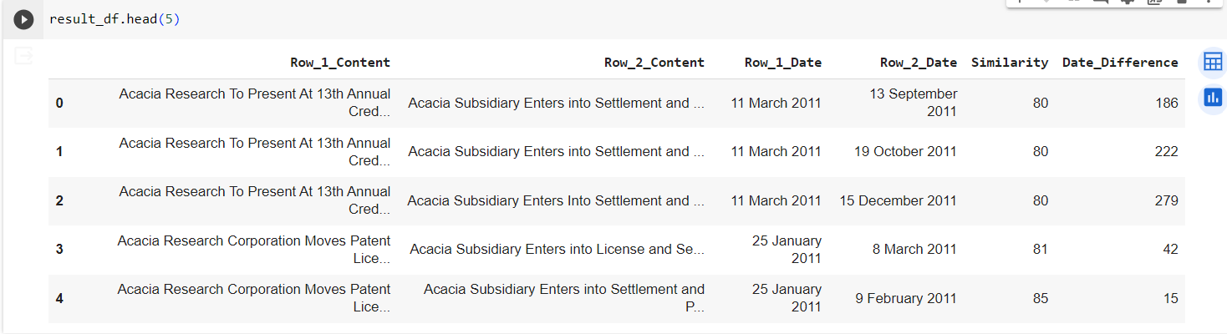
Next Update
Used Fuzzywuzzy similarity score to fetch similar documents.
Removed records that were 100% similar.
Filtered the records that had more than 80% similarity score and calculated the number of days.

Slide 26
Thank you!

